Slide 1
Mario game rules

Slide 2
Watch the video here
https://www.youtube.com/watch?v=rLl9XBg7wSs&ab_channel=Pii89

Slide 3
Other rules
MUSHROOM: make bigger
If I hit with Mario = I disappear.
FLOWER: give fire
If I hit with Mario = I disappear.
STAR: give invulnerable
If I hit with Mario = I disappear.
CHECKPOINT:
If I hit with Mario = i change color to blue.
CAMERA:
Camera always follow Mario
ENEMY
If Mario hit me on the top = I will die.
If Mario hit me but Mario has the STAR = I will die.

Slide 4
mario
star
enemy
Mario
star
star
enemy
Mario star
enemy

Slide 5
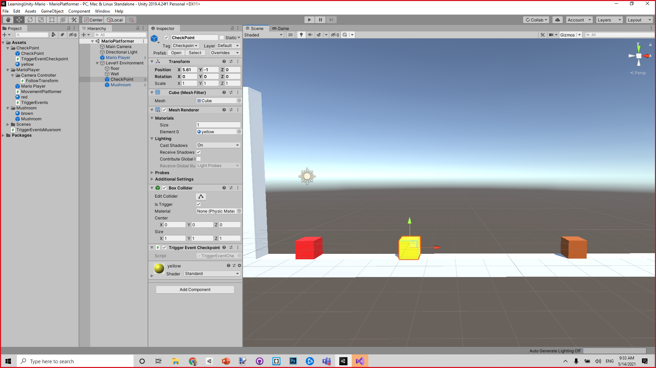
checkpoint
mushroom

Slide 6
MARIO rules
If I hit the star, I become invincible for XXX seconds
If I hit the mushroom,
I become XXX scale
If I hit an enemy:
If I am big, I become small
If I am small:
minus 1 life.
If I have 0 life, I die
If I am invincible, enemy die
If I hit green mushroom, I get 1 life
If I hit checkpoint, save the location of the checkpoint
If I die, restart from last checkpoint
on start of game:
Give mario 2 life
Save start as checkpoint

Slide 7
How to start developing the game
Make the avatar move
OnKey RIGHT , go right
OnKey LEFT, …
OnKeyDown Press UP, jump (animation...).

Slide 8
Plan
Insert 3d model inside the cube (Filippo)
All the big features:
Mushroom, star, enemy
Level design.
From Starting point to finish point
Rules:
Health, damage,
Fire
Killing stuff
Animations

